Slide 1
“ Detecting Building Defects Using Convolution Neural Network” SMART BRIDGE-REMOTE SUMMER INTERSHIP PROGRAM Developed by: > Shreya Karan > Namitha GN > Aishwarya kalal > Ramya R Shet > Meghana G

Slide 2
TABLE OF CONTENTS
> Introduction
> Purpose
> Block Diagram
> Flow Chart
> Software Designing
> Experimental Investigation
> Advantages and Disadvantages
> Conclusion

Slide 3
INTRODUCTION
Detecting of Building Defects is nothing but processing defected and undefected images. The proposed model to has proven to be robust and able to accurately detect and localise building defects. The approach is being developed with the potential to scale-up and further advance to support automated detection of defects and deterioration of buildings in real-time using mobile devices and drones. A defect is a building flaw or design mistake that reduces the value of the building, and causes a dangerous condition.

Slide 4
PURPOSE
Detection of defects including cracks and spalls on wall surface in high-rise buildings is a crucial task of buildings’ maintenance. Clients are increasingly looking for fast and effective means to quickly and frequently survey and communicate the condition of their buildings so that essential repairs and maintenance work can be done in a proactive and timely manner before it becomes too dangerous and expensive.Finally,to predict whether the image is with defected or undefected using CNN from Deep learning algorithms and giving the correct prediction of building status.

Slide 5
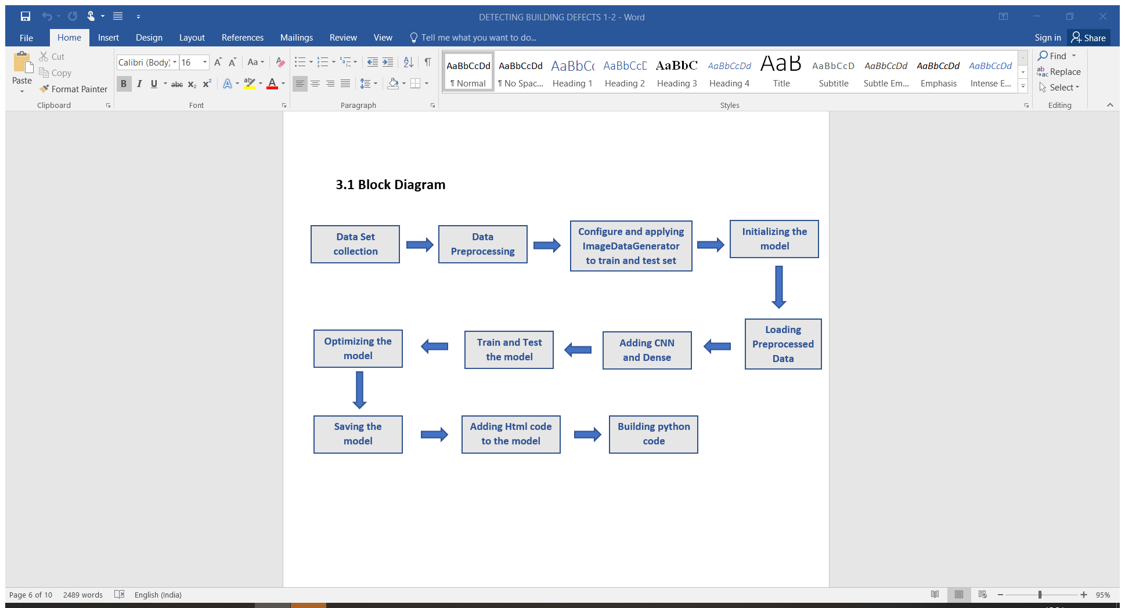
BLOCK DIAGRAM

Slide 6
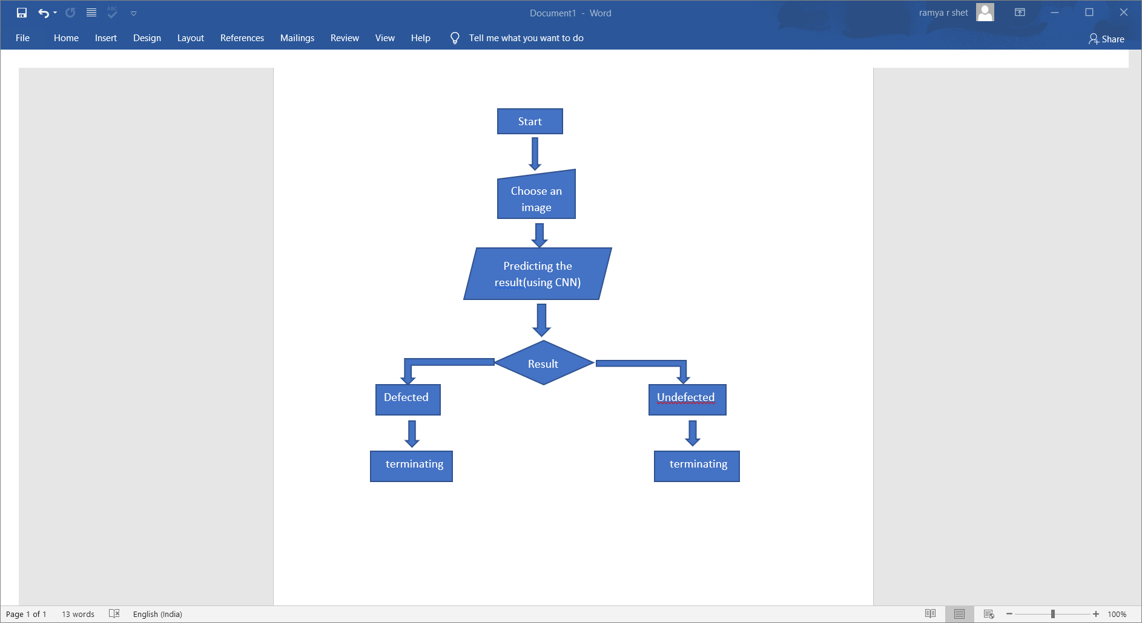
FLOW CHART

Slide 7
SOFTWARE DESIGNING
Jupyter Notebook Environment
Deep Learning Algorithms
Python(ANN , ImageDataGenerator , CNN layers)
We developed this Building Defects prediction by using the Python Language which is a interpreted and high level programming language and using the Deep Learning Algorithms. for coding we used the Jupyter Notebook environment of Anaconda distributions, it is an integrated scientific programming in the python language

Slide 8
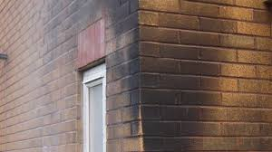
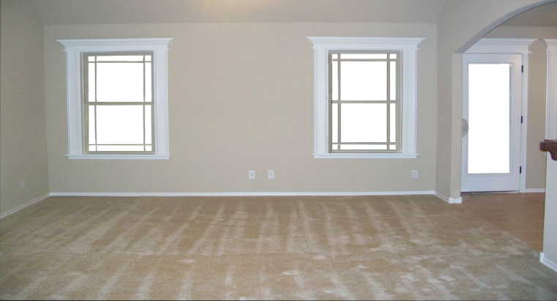
EXPERIMENTAL INVESTIGATION Defected Undefected
In this project we have created a dataset by collecting the images of defected and undefected buildings. Those collected images are shown below.
The next step is to build the model. The CNN layers will detect the choosen images and gives the result

Slide 9
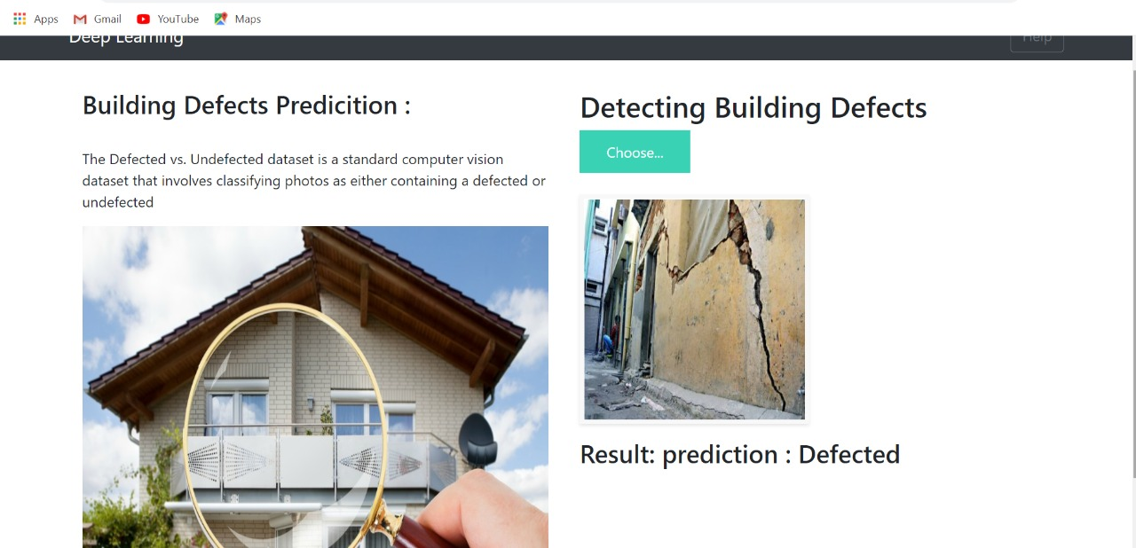
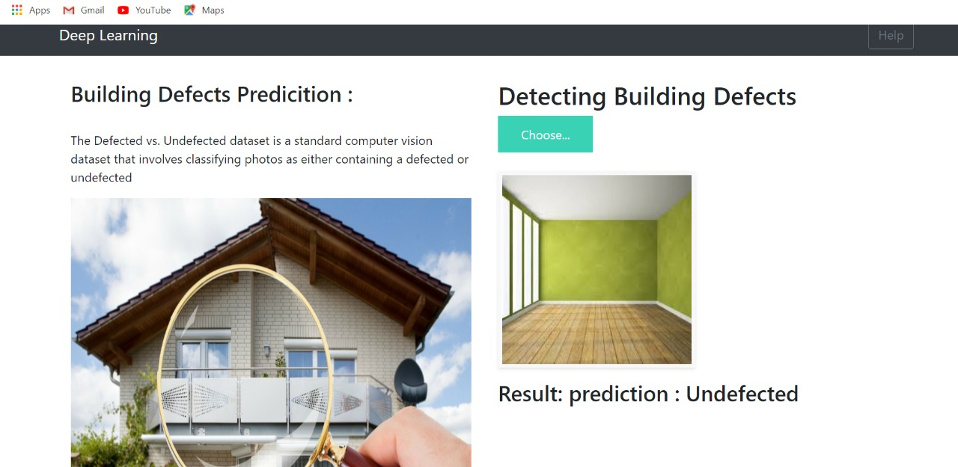
Contd..
The results are shown below.
(a) result :prediction: Defected
(b) result :prediction: Undefected

Slide 10
ADVANTAGES & DISADVANTAGES
ADVANTAGES
Image Classification using CNN model is widely used as they are powerful in achieving high accuracy with minimum error rate.
The main advantage of CNN compared to its predecessors is that it automatically detects the important features without any human supervision.
DISADVANTAGES
Lack of ability to be spatially invariant to the input data.
They do not encode the position and orientation of the object into their predictions.

Slide 11
CONCLUSION
This Project proposes an effective detecting building defects method using CNN layers and predction including movement containing region detection based on cracked ,patched,stain and uncracked smooth walls. The results show that the proposed algorithm achieves good detection rates.These results indicates that the proposed method is accurate and can be predicted by image process using concept of deep learning

Slide 12
THANK YOU

